Slide 1
Java JComboBox

Slide 2
JComboBox Component
A combo box allows the user to select an item from a list of items.
Combo boxes are sometimes called drop-down lists because when you click the combo box's down arrow, a list of selection items drops down.
After a selection is made, the item list disappears and only the selected item is displayed.
Combo boxes are called "combo boxes" because they are a combination of a text box (normally, they look like a text box) and a list (when the down arrow is clicked, they look like a list).

Slide 3
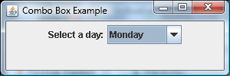
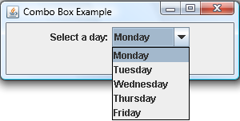
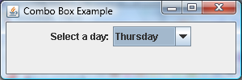
JComboBox Component
Example: the user selects a day from among the five weekdays
1. Initial display:
2. After user clicks on down arrow:
3. After user clicks on Thursday:

Slide 4
JComboBox Component
How to implement a combo box:
Create an array of list options:
private String[] days =
{"Monday", "Tuesday", "Wednesday", "Thursday", "Friday"};
Create a combo-box object by passing the array to the JComboBox constructor:
JComboBox<String> daysBox = new JComboBox<>(days);
Notes:
1. This is the code we used to create the select-a-day combo box in the previous slide.

Slide 5
JComboBox Component Methods
void setVisible(boolean flag)
Makes the component visible or invisible.
void setEditable(boolean flag)
Makes the combo box's top portion editable or non-editable.
Object getSelectedItem()
Returns the item that is currently selected.
void setSelectedItem(Object item)
Changes the currently selected item to the item that's passed in.
void addActionListener(ActionListener listener)
Adds a listener to the combo box.
Notes:
1. The setVisible and addActionListener methods should look familiar since we showed them with our previous components.
2. Combo boxes are non-editable by default.
If you make a combo box editable, then it will have the combined functionality of a text box and a drop-down list.
That's why they're called combo boxes.
If the user enters text into the top portion of an editable combo box, the drop-down options don’t change, but the selected value does change to the entered value, as evidenced by the returned value from getSelectedItem….
3. Note that getSelectedItem's return type is Object.
So if you assign getSelectedItem to a string variable, you’ll need to use a cast operator like this:
String day = (String) daysBox.getSelectedItem();
4. Normally, you'll store strings (which are objects) in a combo box, but you can store any type of object.
For example, you could store ImageIcon objects (Chapter 16) in your combo box.
5. What happens if the item argument is not in the list?
If the combo box is uneditable, the combo box's current selection will not change.
If the combo box is editable, the combo box's current selection will change to the item argument.

